Slide 1
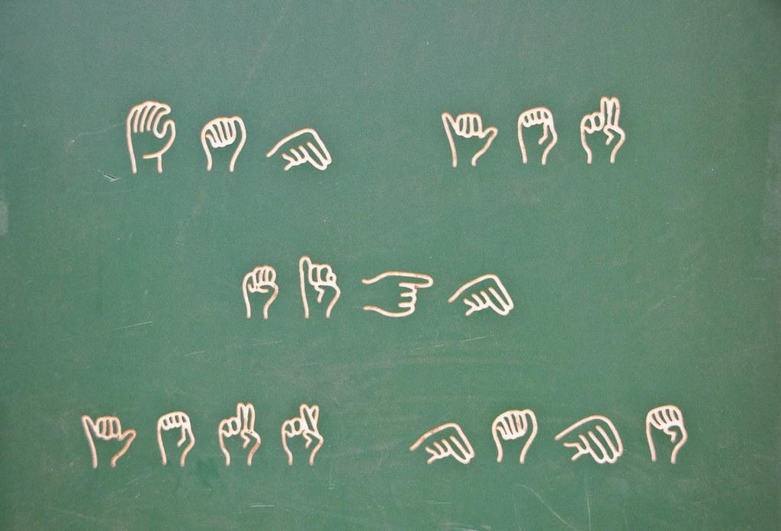


Minor Project Submitted to
Rajiv Gandhi Proudyogiki Vishwavidyalaya, Bhopal
Towards Partial Fulfillment for the Award of
Bachelor of Engineering
(Computer Science and Engineering)
Supervised By: Guided by:
Ms. Divya Gupta Ms. Nisha Rathi

Slide 2
Sign Language Converter

Slide 3
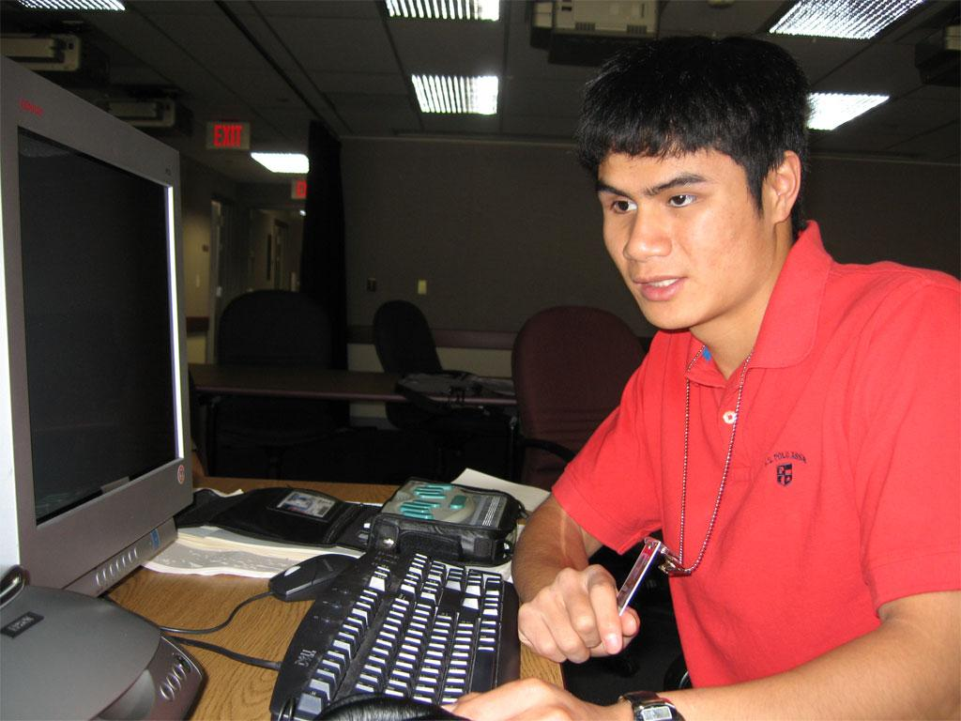
PURPOSE
This project will help a person who has learning disability to communicate with others and vice versa. Thus, eliminating the need of translator between them.

Slide 4
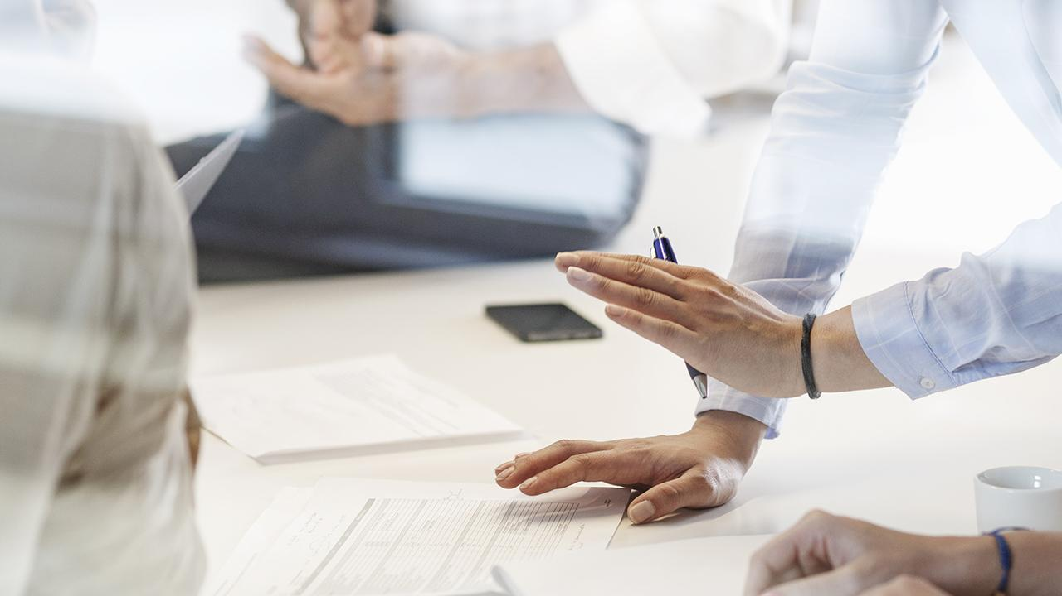
Sign Language Converter is an application which can be used to convert audio to text and then to sign language. The project is a machine learning program that detects and recognizes audio signals received to text using speech to text API (python modules and Google API) and then making a visual presentation (video) of the converted sign language which requires machine learning as a part.
INTRODUCTION

Slide 5
SCOPE
This can be used to help disabled people.
This can be used by people to understand the sign language and help those people communicate through it.
This can be used on wide scale to make most of the public understand what a person is trying to convey to the world through sign language.
This will prevent the disabled people from hiring other people who can speak and understand sign language just to be their communicator.
This can be implemented with other technologies too like iot, android and thus has a lot of scope

Slide 6
PRODUCT FUNCTION
Audio input on a Personal Digital Assistant(PDA) using python PyAudio module
Conversion of audio to text using Google Speech API.
Dependency parser for analysing the grammatical structure of the sentence and establishing relationship between words.
ISL Generator: ISL of input sentence using ISL grammar rules.
Generation of Sign Language with signing Avatar.

Slide 7
GENERAL CONSTRAINTS
The only disadvantage of the programming language is its speed.
Python is not the fastest programming language still it is versatile and adopted broadly.
Noise in background may cause application to generate error-prone results.

Slide 8
Specific Requirements
Sign Language Converter

Slide 9
Functional Requirements
Sign Language Converter

Slide 10
Operating System: Windows XP/Windows 10/ Windows 7/ Linux
RAM: 2GB recommended
Hardware Devices: Keyboard with mouse
Hard disk: 10 GB or more
Display: Standard Output Display
Audio: Microphone (preferred)
Hardware Requirements

Slide 11
Technology Implemented: Machine Learning
Language Used: Python
User Interface Design: Trinket
Model: Spiral Model
Software Requirements

Slide 12
Non Functional Requirements
Sign Language Converter

Slide 13
The Audio to Sign Language Converter is based on python. The program shall take initial load time depending on internet connection strength. The performance shall also depend upon hardware components of the client.
PERFORMANCE

Slide 14
Python is very reliable. The language has been around for over 20 years, and is in use in tens of thousands if not more sites. Python is actively maintained, so when problems are reported, they are dealt with promptly. But of course it is a programming language, which means the reliability of code you write depends on your skill at programming. If you write buggy code. Python cannot save you from your own errors.
RELIABILITY

Slide 15
The user should have Internet connection technology in the device and a well charged device.
AVAILABILITY

Slide 16
Python is a very secured programming language. Thus, the application made is highly secured.
SECURITY

Slide 17
The product is highly portable as it can be accessed from any device with any operating system.
PORTABILITY

Slide 18
The product is highly portable as it can be accessed from any device with any operating system.
FAULT TOLERANCE

Slide 19
SDLC MODELS
Sign Language Converter

Slide 20
Model used
Sign Language Converter

Slide 21
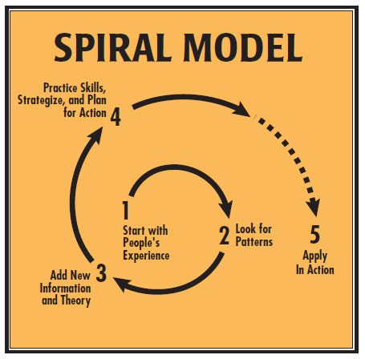

Slide 22
Additional functionality or changes can be done at a later stage
Cost estimation becomes easy as the prototype building is done in small fragments
Continuous or repeated development helps in risk management
Development is fast and features are added in a systematic way
There is always a space for customer feedback
WHY SPIRAL MODEL ???

Slide 23

THANK YOU!

